Slide 1
Task -4 Register all the spring boot applications with Eureka Server & establish communication them
Yogita Balpande
23/06/2020

Slide 2
Problem Statement
Final step is used to eureka service registry to automatically register the applications and
Communicate without specifying IP address and port.
Eureka provides way to add required details in .preoperties files and get register on Eureka server.

Slide 3
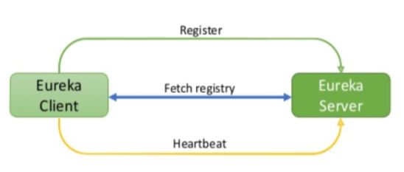
Service Registration
Register at startup
Send a heartbeat every 30 seconds indicating they are alive.
Provide client-side registry cache(in-memory).

Slide 4
Service Registration
local Host (127.0.0.1)
Account : 9090
Eureka Client1
Eureka Server : 8761
Custmer: 8080
Eureka Client2

Slide 5
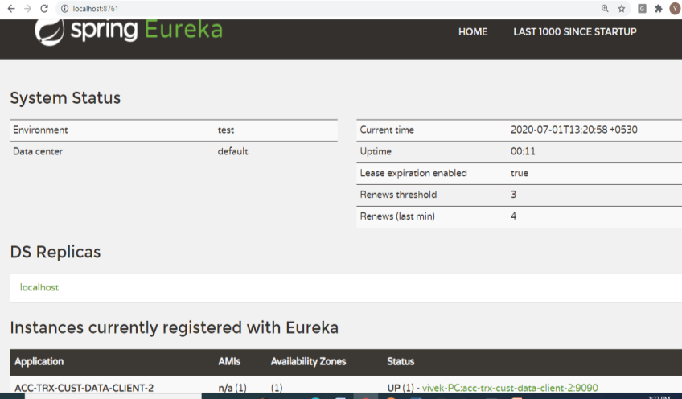
Eureka Server Dashboard

Slide 6
Demo
Thank You
Any Q ?.........

